Slide 1

EXPLORATORY DATA ANALYSIS (EDA)
Presented By:
Fantastic Group

Slide 2
Contents
Introduction to Team and Dataset
Problem Statement
Our Work
Tools and Technology
Conclusion

Slide 3

MEET THE TEAM
IMRAN ALI SOOMRO
GUL MUNIR HASSAN
HAMNA ASIF
ZAYN RAJAR

Slide 4



INTRODUCTION TO DATASET
HEART ATTACK PREDICTION

Slide 5
Problem Statement
What we will achieve from EDA of this Dataset.
What is the Importance of this Dataset.
At What attributes Heart Attack depends the most.
We can observe the different attributes of Dataset.
If we decrease any attribute, then what effect will be observed on the Output.

Slide 6

OUR WORK
EDA

Slide 7
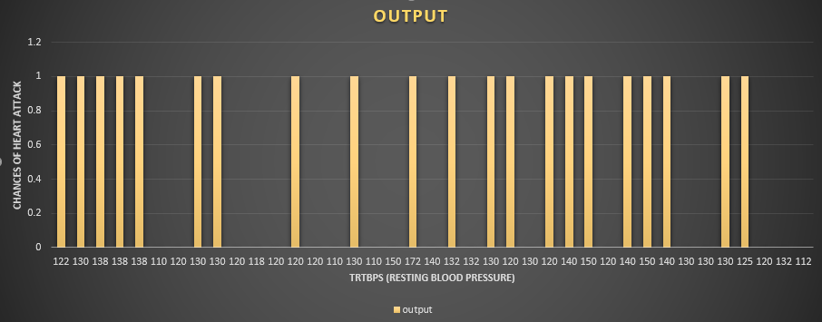
Relationship of Resting Blood Pressure with Chances of Heart Attack
Total record = 39
People having BP above 120 == 25
People having BP <= 120 == 14
People having increased chances of attack == 21
People having less or no chance of attack == 18
Normal blood Pressure = 120

Slide 8
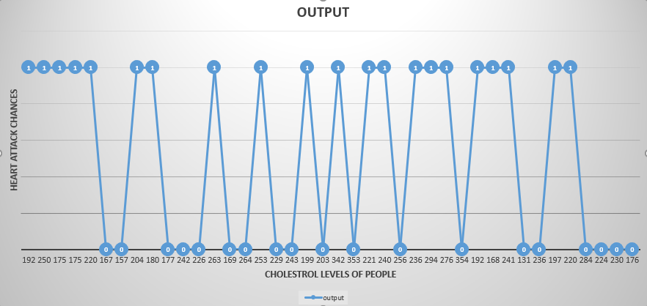
Relationship between Heart Attack Chances with Cholesterol Level
Normal Cholesterol level == 200 mg/dl
People having risk of getting Heart Attack == 21
People having no risk of Heart Attack == 19
Total Record == 40

Slide 9
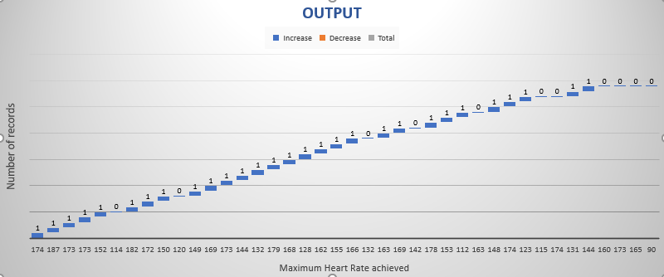
Relationship of Maximum Heat rate with Chances of Heart Attack

Slide 10
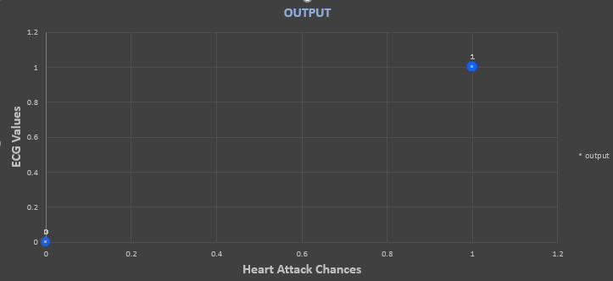
Relationship between ECG values and Chances of Heart Attack

Slide 11
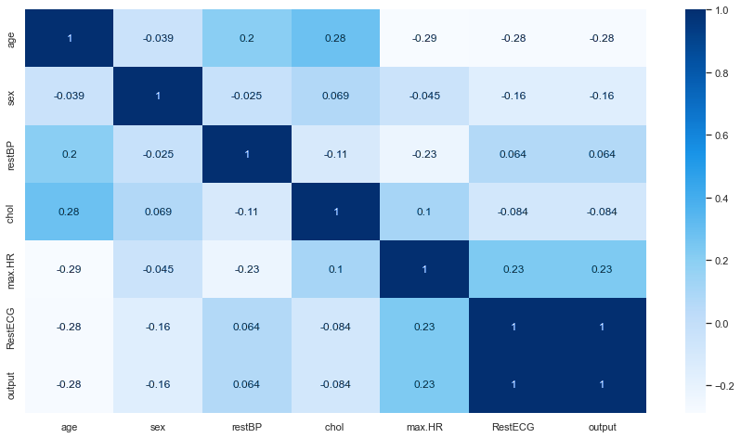
Correlation of the Dataset

Slide 12




Tools and Technologies

Slide 13

Coclusion
Bhaar me jae Conclusion panr hi kando jehnjo topic aah

